Slide 1
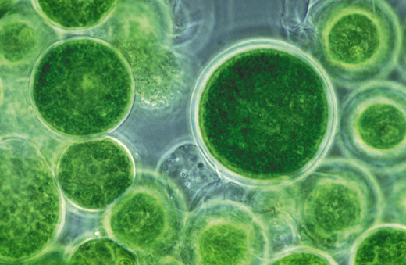
Ves4us
PROJECT
Extracellular vesicles for molecular delivery system
The Ves4us project is an European initiative funded by the Horizon2020 Program of the European Commission under Future Emerging Technologies (FET) call. Its main objective aims at generating a broad range of radically new high-value products in the fields of nutrition, cosmetics and health sciences based on natural source-derived extracellular vesicles (EVs), which could be used as new generation vehicles for specific molecular delivery.
This project has received funding from the European Union’s Horizon 2020 research and innovation programme under Grant Agreement No 801338
6
36
3M
6
PARTNERS
MONTHS
TOTAL BUDGET
COUNTRIES
IN ONE CLICK
Coordinator
Programme
Period
CNR
HORIZON 2020
2018-2021
Sector
Web
RESEARCH
Soon: www.ves4us.eu
01
02
03
The Challenge
The Solution
Impacts
The discovery of EVs as natural carriers of functional small molecules and proteins has raised great interest in the drug delivery field as it may be possible to harness these vesicles for the therapeutic delivery of peptides and synthetic drugs. As well as, the development of new EV related technologies that haven’t been used until now.
To develop a biocompatible and cost-effective vesicle based drug delivery system, which would enhance bioavailability and improve the efficacy and safety of loaded bioactive compounds. It proposes a high-risk high-gain approach to further develop the technological processes inherent to EV isolation from a natural source and their subsequent functionalization in the view to amalgamate them in a highly cooperative frontier research strategy.
The metabolic attributes of natural source EVs are actively researched worldwide to address strategic priorities from sustainable sources. This project will contribute to national and EU research agendas providing a new EU perspective on frontier biotechnology, translation fundamental work outputs into market-led opportunities relevant to the nanomedicine, cosmetic and nutraceutics sectors.

